Slide 1
Career Ocean Website

Slide 2
Career Ocean
Submitted By :-
Bhalala mitesh
Savaliya keval
Submitted To :-
Shree S.V.Patel College Of com. Science and Business Mgt.
Internal Guide :-
External Guide :-
Mrs. Hina jayani

Slide 3
Project Profile
Career Ocean Website
Microsoft Windows 8
Project Title :-
PHP Codeigniter
Platform :-
Php & MySql
Front End :-
Php Codeigniter
MySql
Back End :-
Development Tools :-
Apache server
Veer Narmad South Gujarat University, Surat.
Web Server :-
Submitted To :-

Slide 4
Environment
Specific
Processor :- Intel core i7
RAM :- 4 GB
Hard disk :- 500 GB
Hardware Requirement :-
Operating System :-Windows- 8,Windos-10
Front end tool :- PHP, Codeigniter
Back end tool :- MySql
Browser :- Google Chrome , Mozilla Firefox
Software Requirement :-

Slide 5
Place mart is new Concept of Providing the Job ,workshop and Course in one platform
This is the best site for developer they need job in reputated company and give interview in this company and getting chance to be a developer of this company
Its also good for student they need knowledge in particular course with pdf and faculty videos also and this side also useful to participated in workshop of many big companies.
Placemart Provide the best solution to get job without any tension.
Placemart provide the Event management so User participated in event and enjoy their life according to they want.
Objective

Slide 6
User enter account details, contact details, and resume summary, education details, upload resume information to become a member.
Free resume posting during the registration.
User easily login with their username and password.
User can update the profile
Quick job search - Enter any keyword to search jobs.
User can save the jobs when they are searching the jobs in the site.
User can apply the jobs from the saved job list.
Jobseeker Section

Slide 7
Maintain the administrator username and password.
Queries or comments are posted by user.
Reply queries or comments to the user.
Admin can edit this information and in user view these.
These updates are viewed in the payment package details in user view section.
Maintains the Job name, days allowed, number jobs. The admin update and delete and add these details.
Send the news letter about the jobs site to the job seekers.
Send the news letter about the jobs site to the recruiters.
Maintain active and inactive job.
Admin Section

Slide 8
Apply to multiple jobs with a single click.
Access unadvertised jobs.
Registered or unregistered user both can watch job.
Notification and message sending by Company to users.
Apply for jobs from your mobile.
Get best jobs delivered to your inbox.
Get clarity on jobs.
Advantages

Slide 9
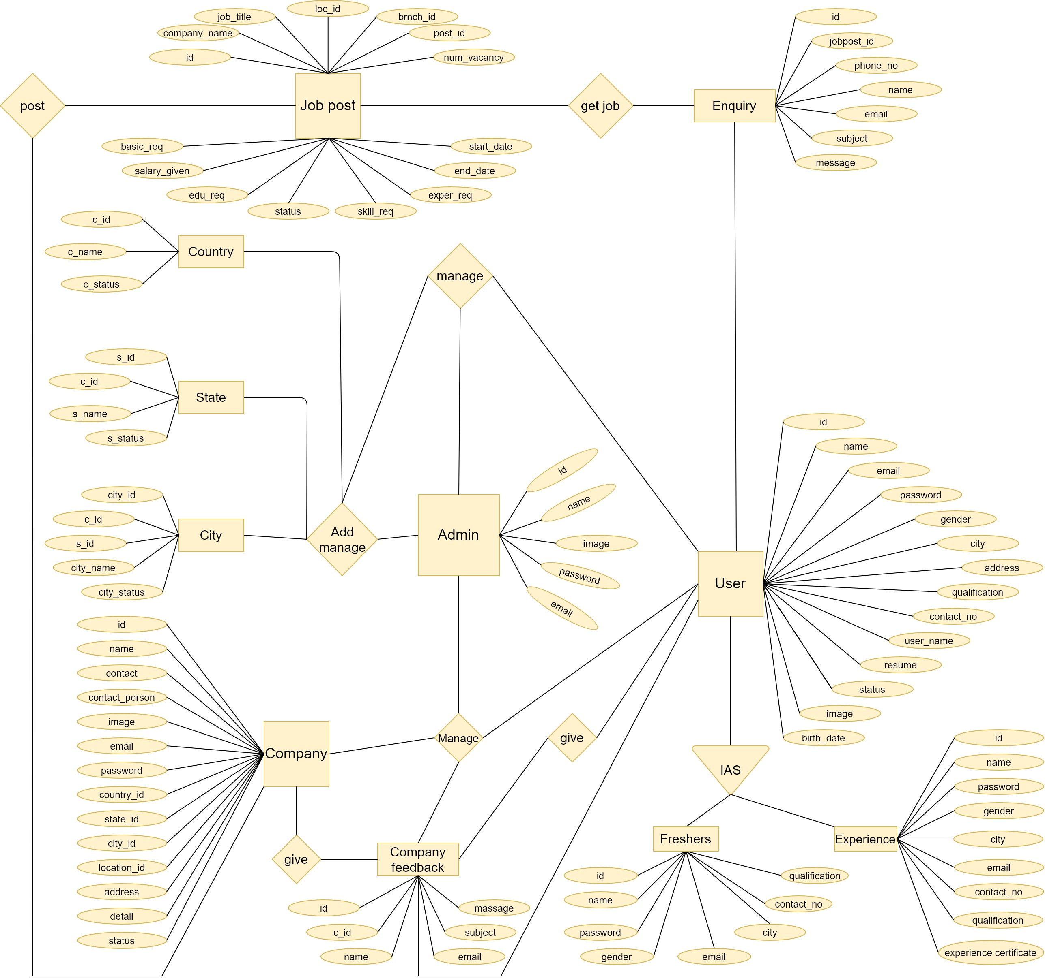
Entity Relationship Diagram

Slide 10
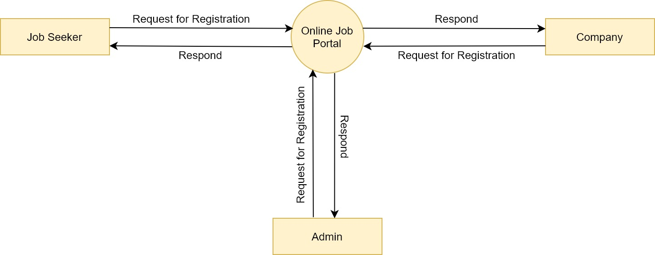
Data Flow Diagram
Context level data flow diagram

Slide 11
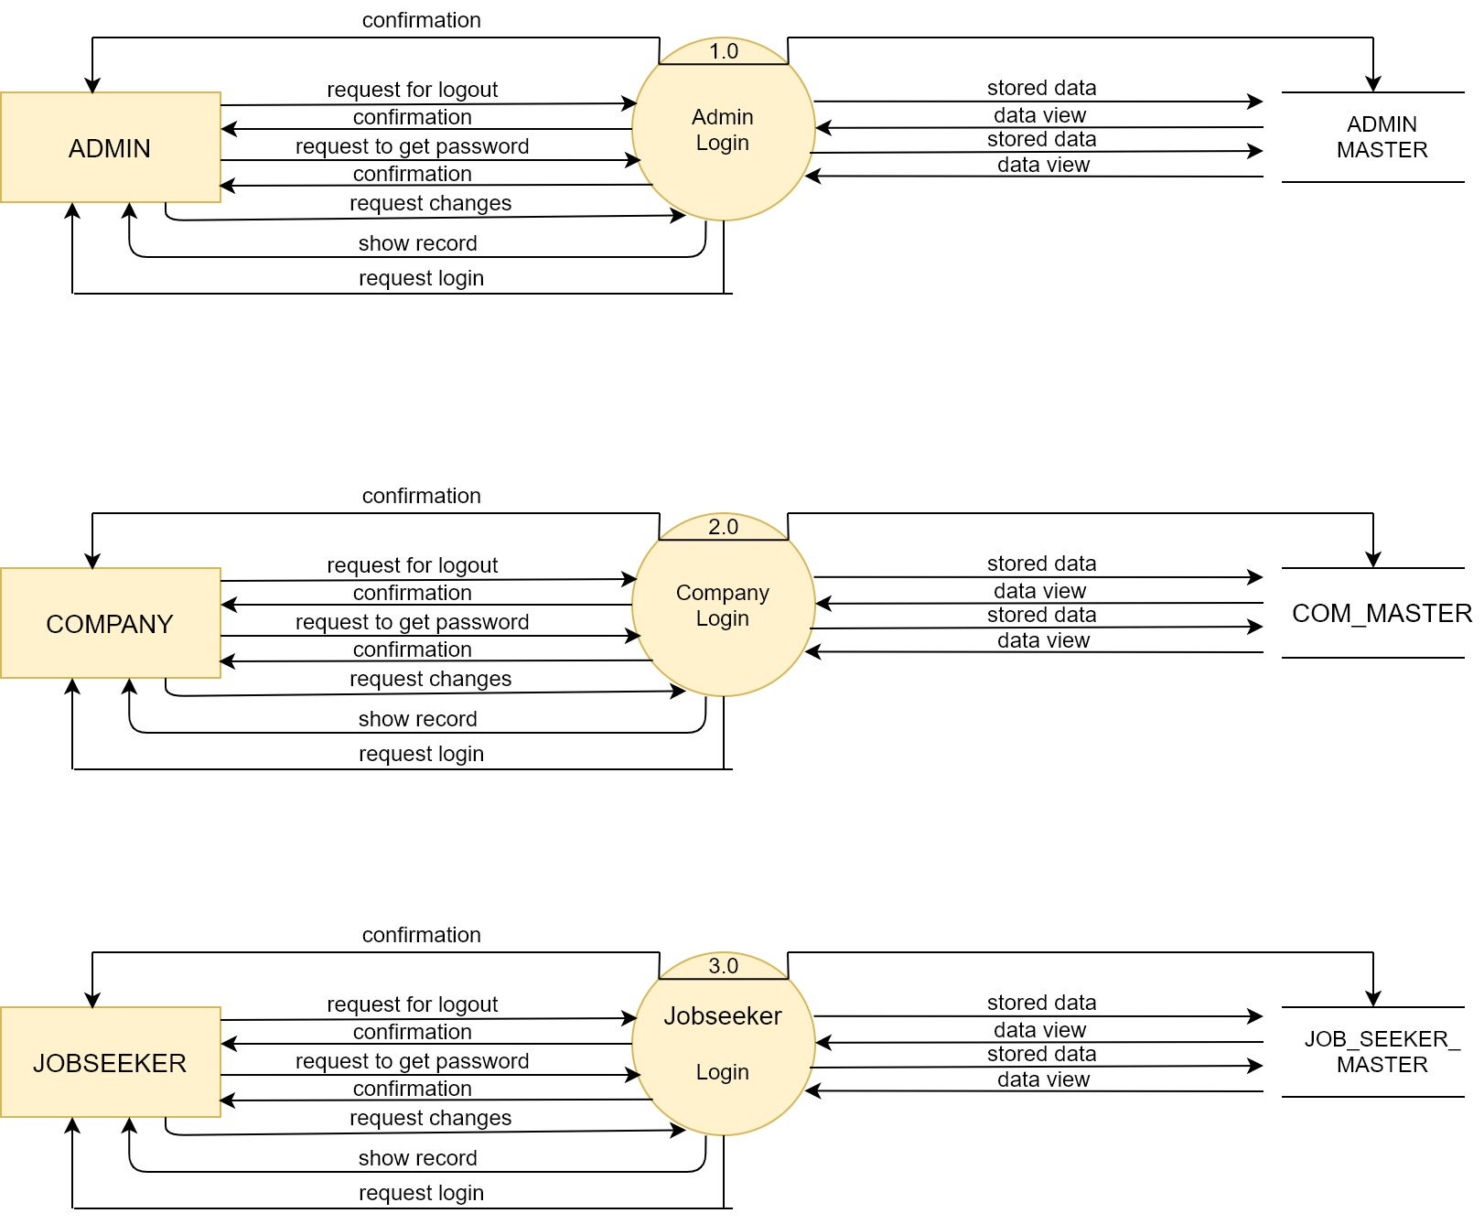
First Level

Slide 12
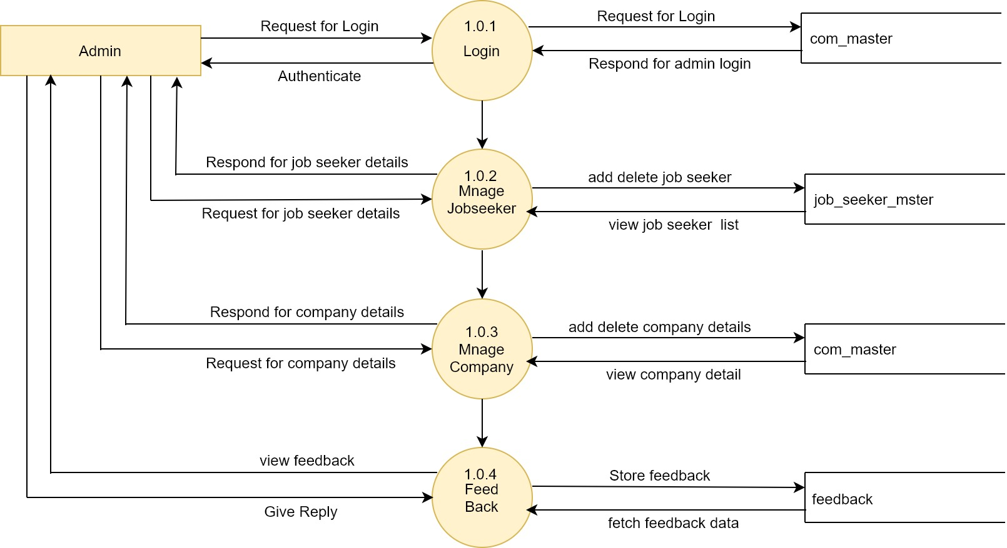
Second Level

Slide 13

Snapshots

Slide 14
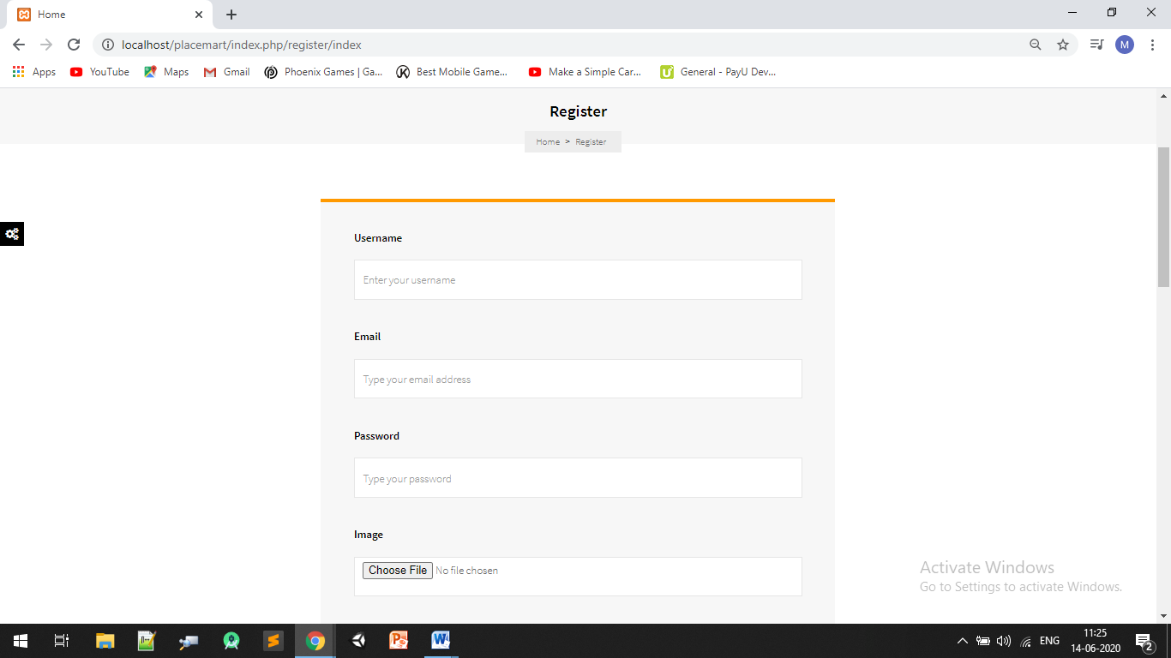
Place your screenshot here
User Registration
14

Slide 15
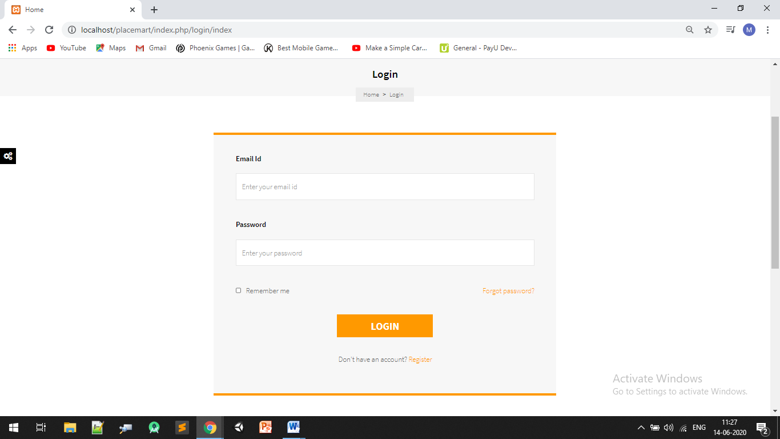
Place your screenshot here
User Login
15

Slide 16
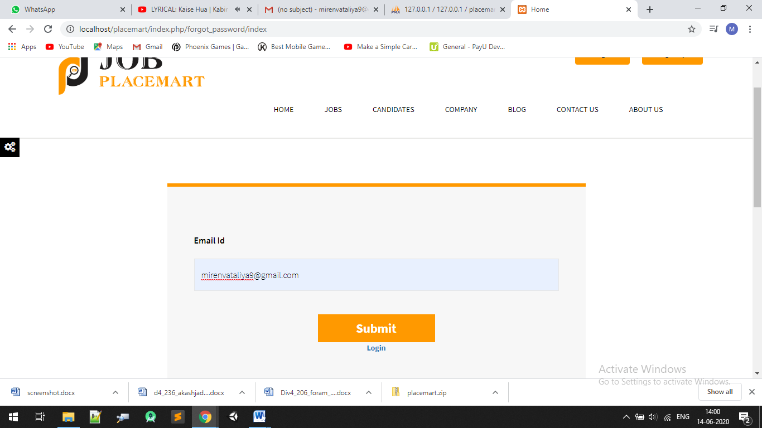
Place your screenshot here
Forgot Password
16

Slide 17
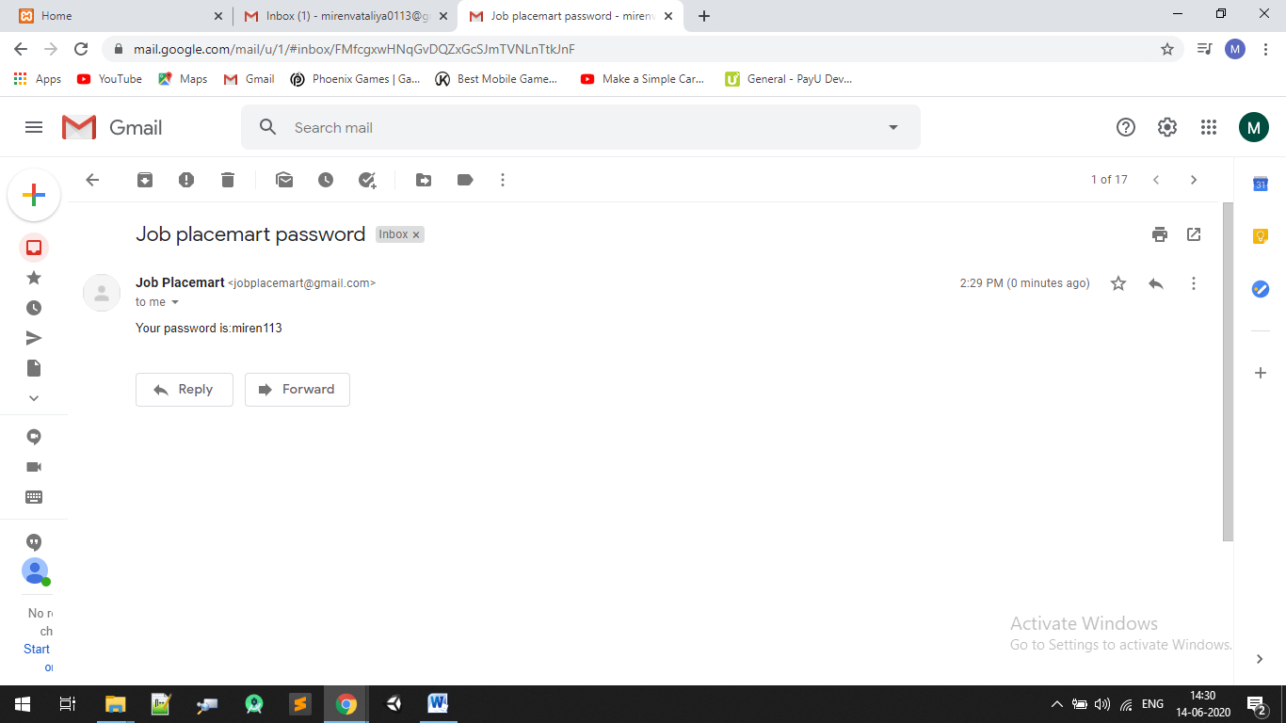

Slide 18
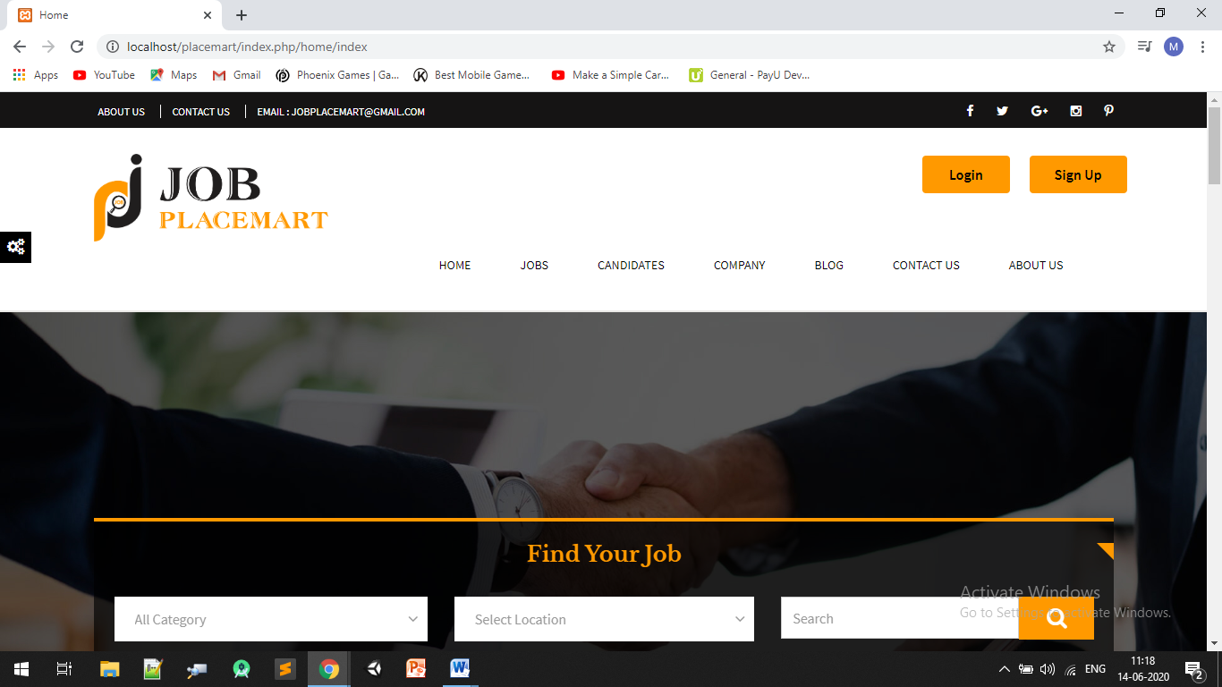
Place your screenshot here
Home Page
18

Slide 19
Place your screenshot here
Job Page
19

Slide 20
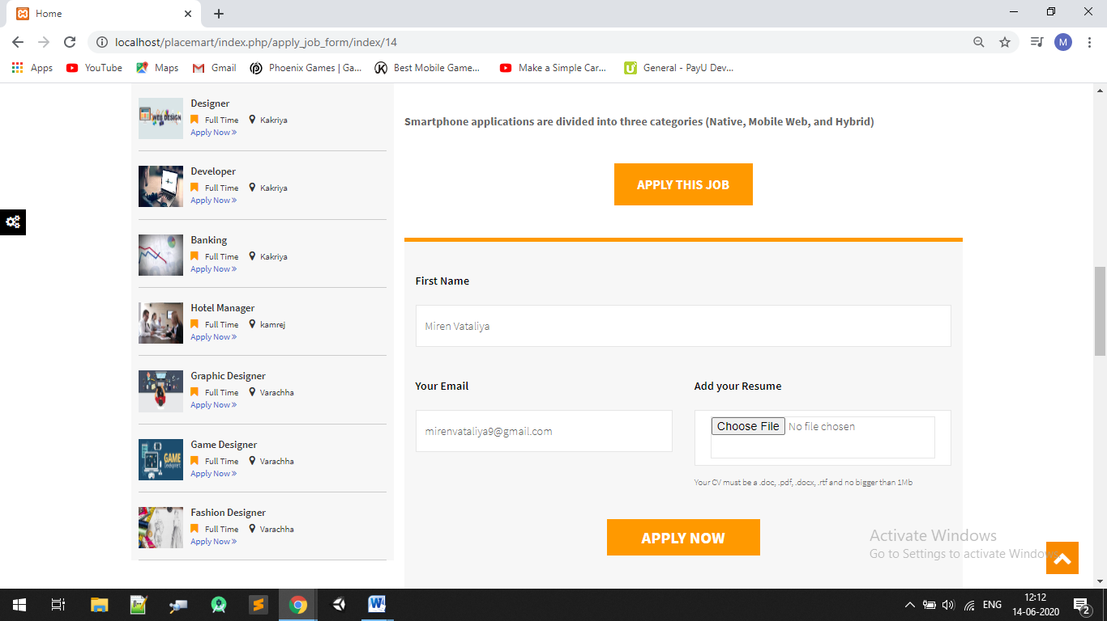
Place your screenshot here
Apply Now Job Page
20

Slide 21
Place your screenshot here
Apply Now Job Page
21

Slide 22
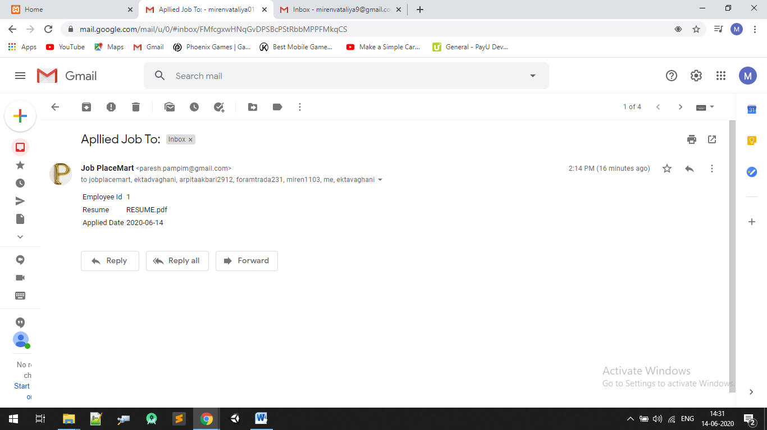
Place your screenshot here
Inform to Admin and Company Using Mail
22

Slide 23
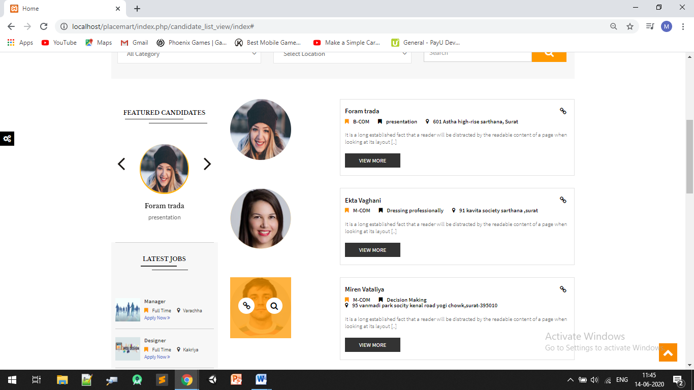
Place your screenshot here
Candidates Page
23

Slide 24
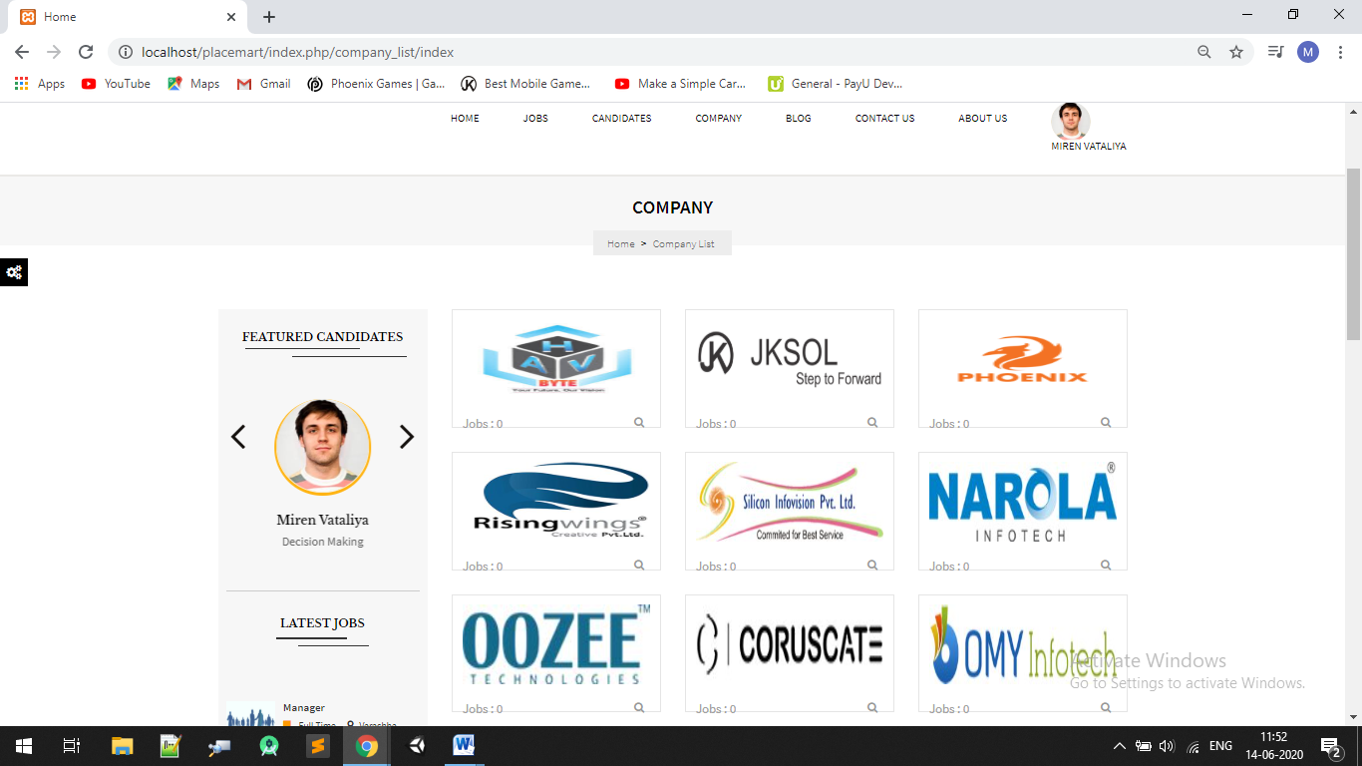
Place your screenshot here
Company Page
24

Slide 25
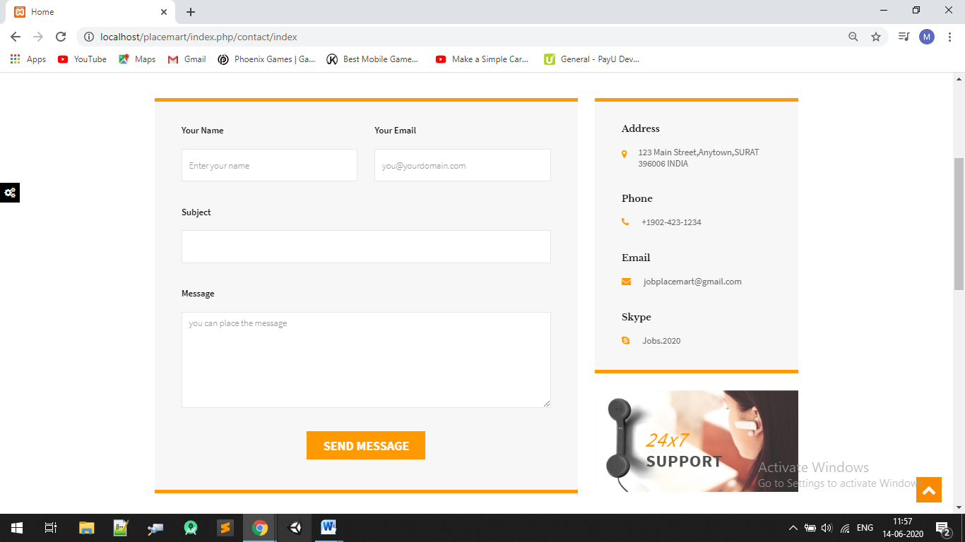
Place your screenshot here
Contact Us
25

Slide 26
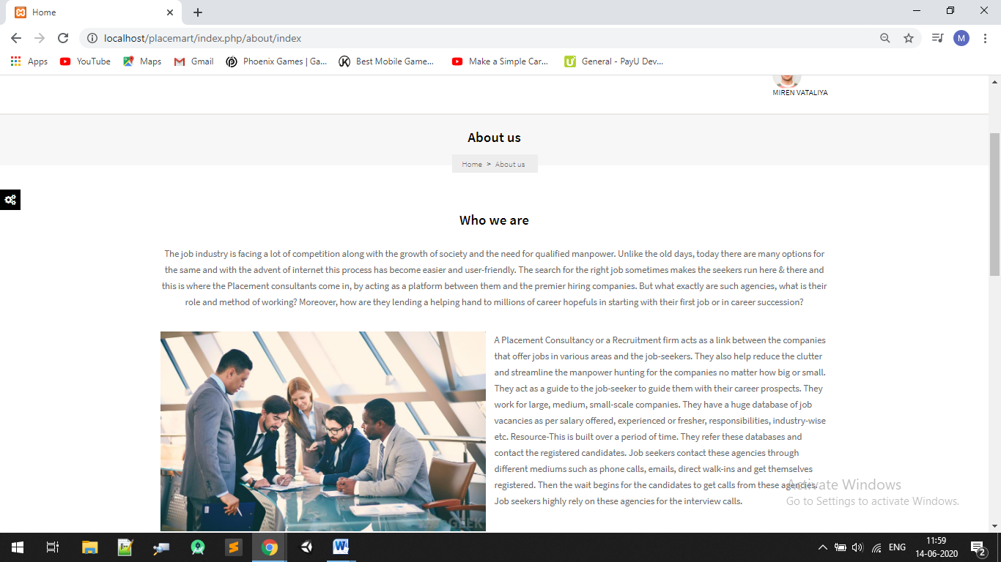
Place your screenshot here
About us Page
26

Slide 27
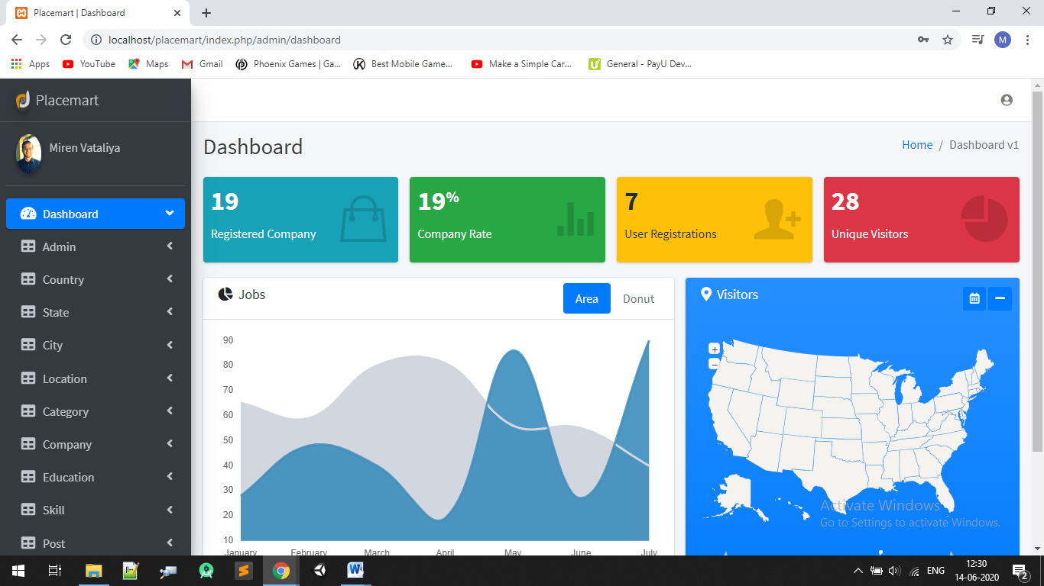
Place your screenshot here
Admin Dashboard
27

Slide 28
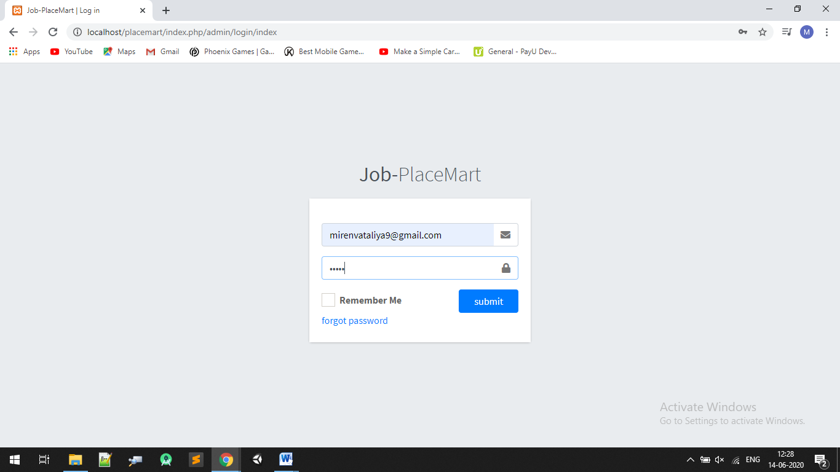
Place your screenshot here
Admin login page
28

Slide 29
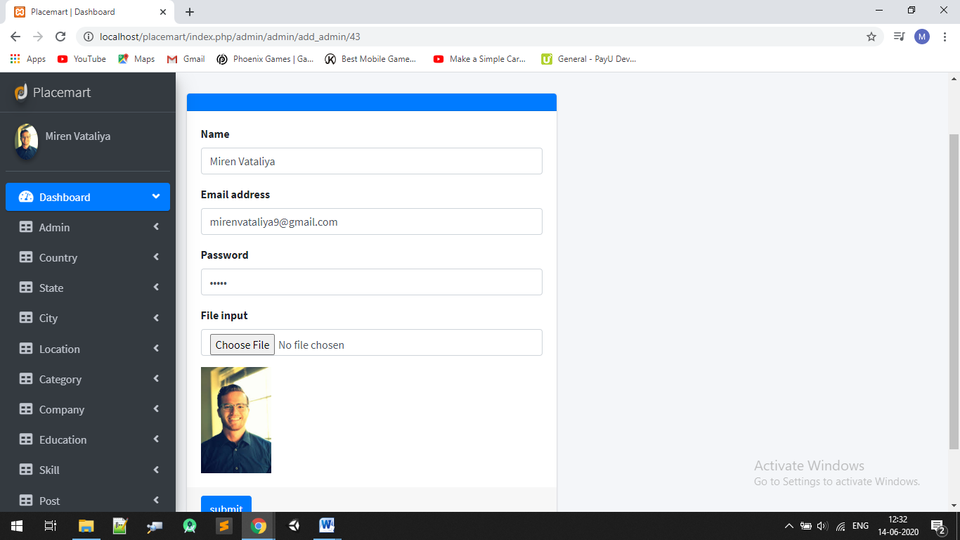
Place your screenshot here
Edit Profile
29

Slide 30
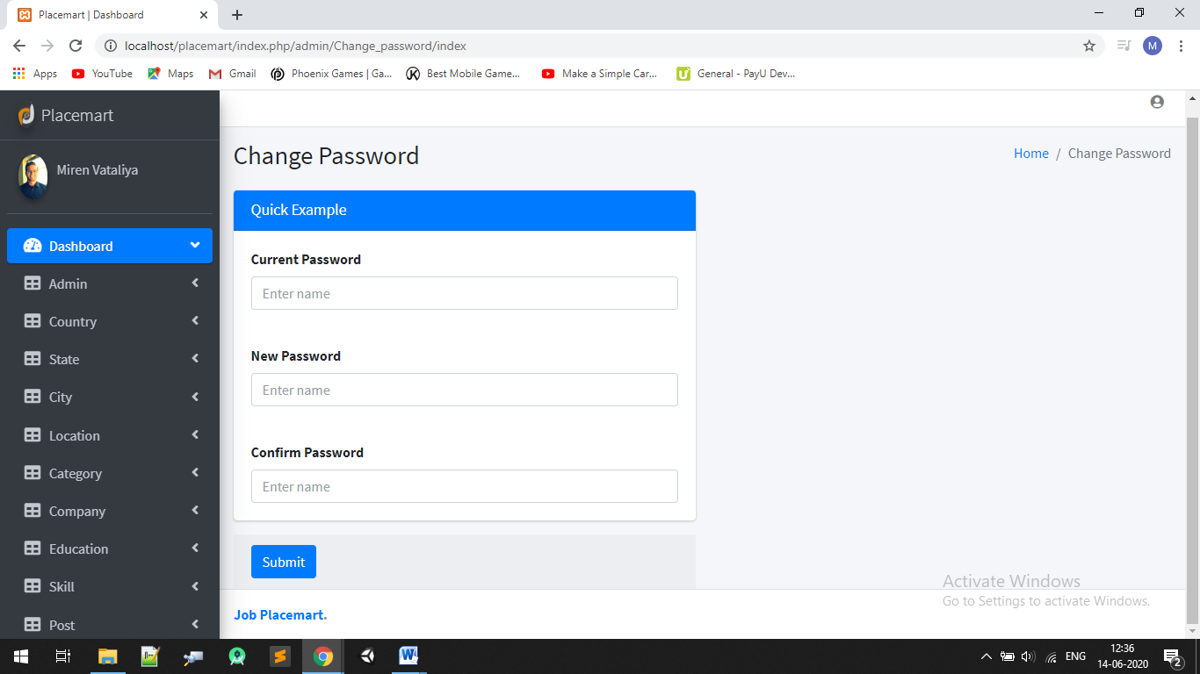
Place your screenshot here
Change Password
30

Slide 31
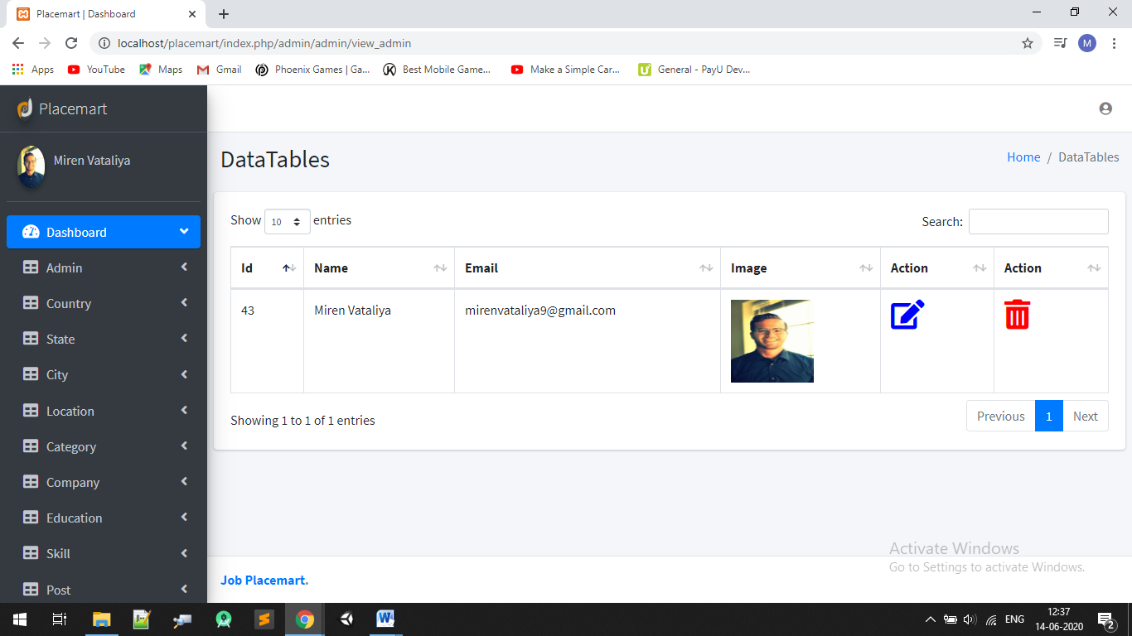
Place your screenshot here
Data Tables
31

Slide 32
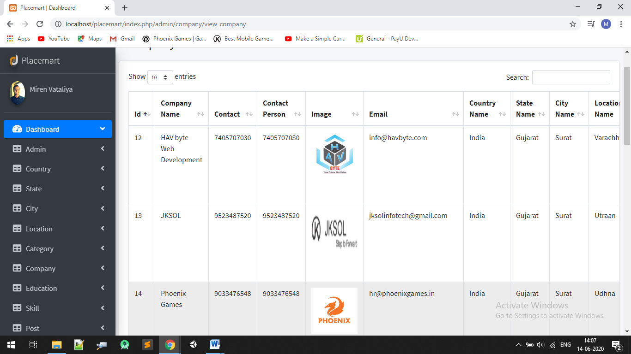
Place your screenshot here
Company Table
32

Slide 33
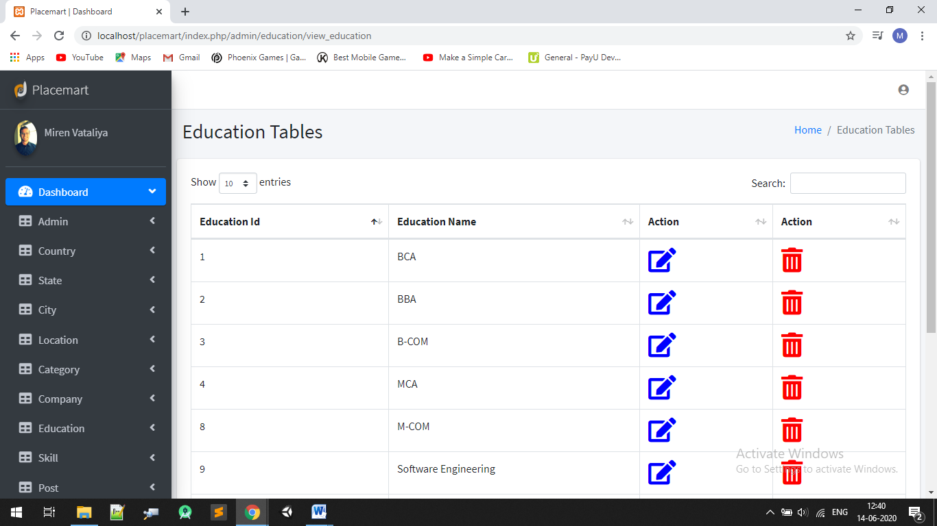
Place your screenshot here
Education Tables
33

Slide 34

Place your screenshot here
Post Tables
34

Slide 35
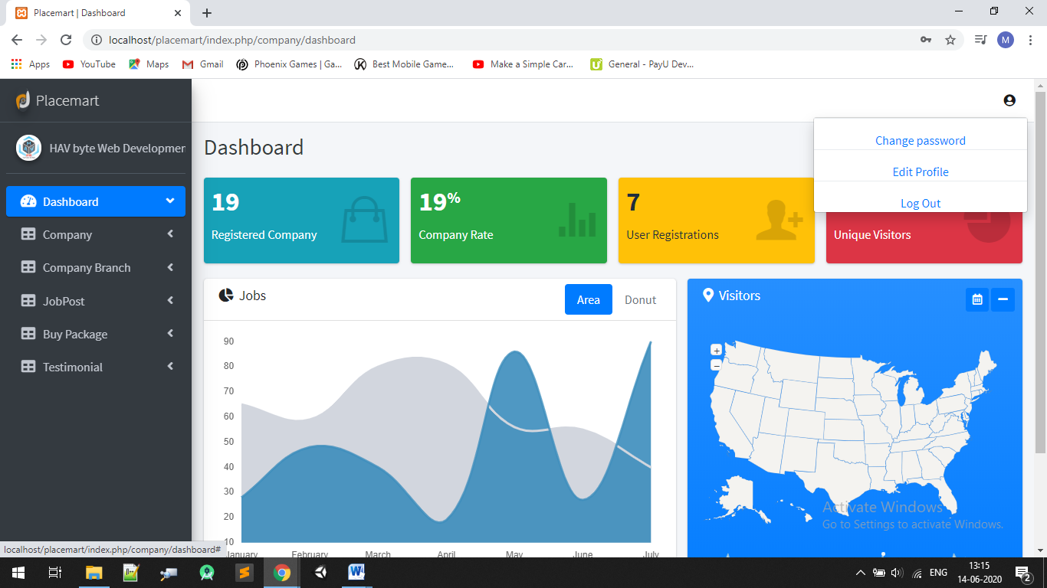
Place your screenshot herev
Company Dashboard
35

Slide 36
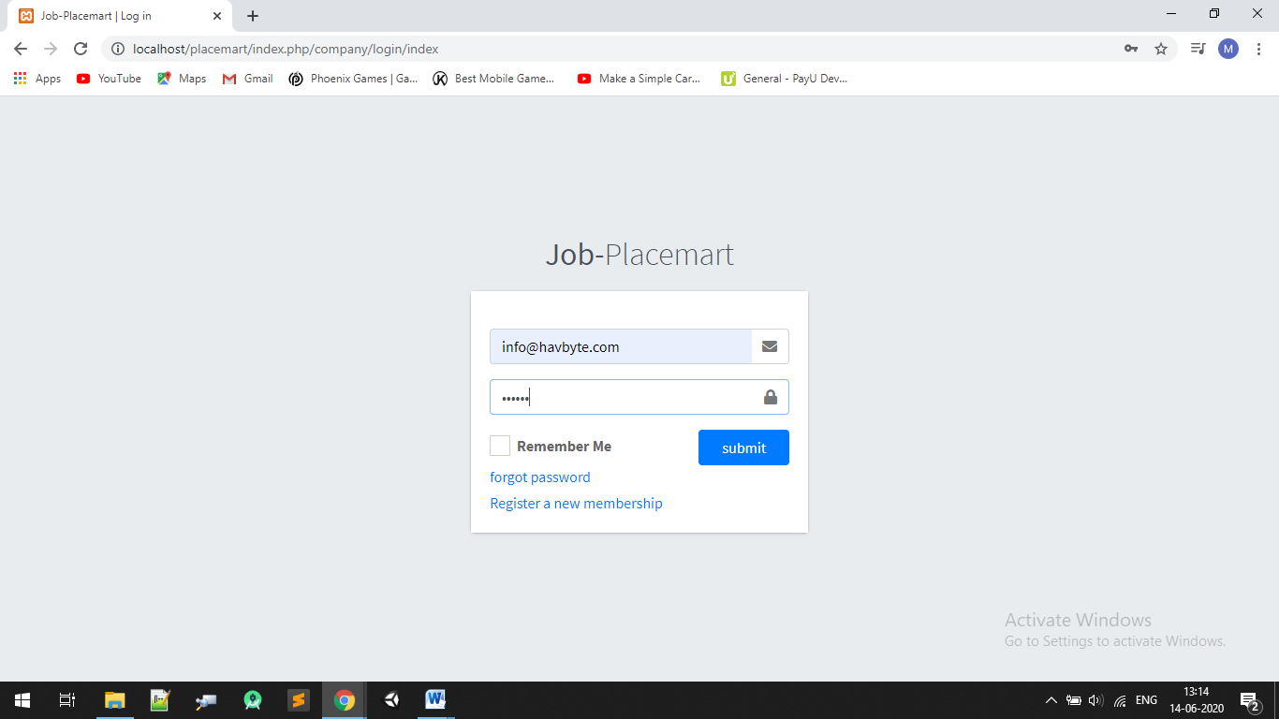
Place your screenshot here
Company login Page
36

Slide 37
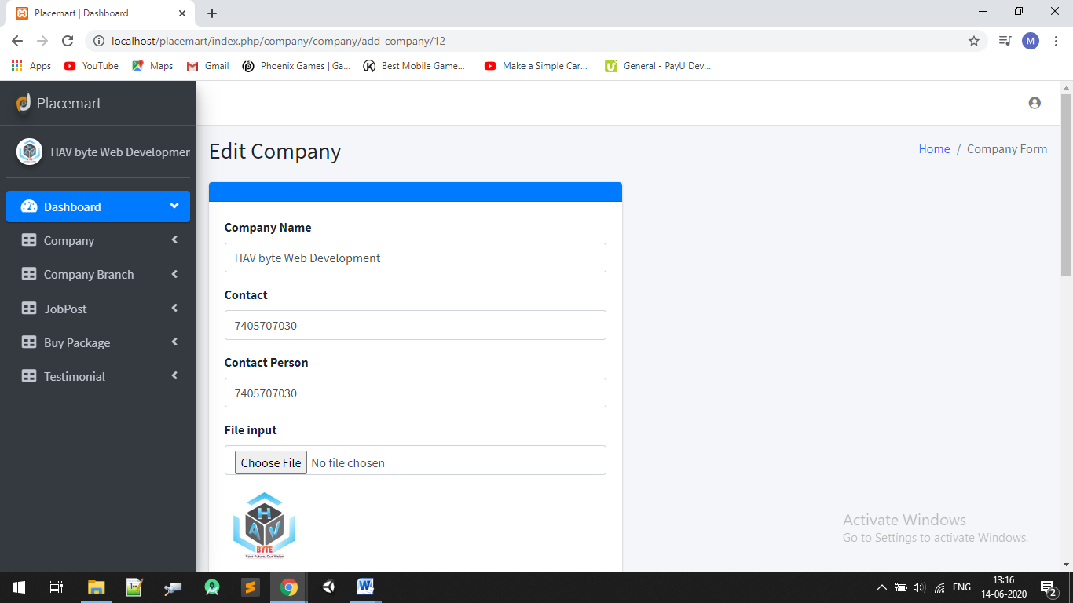
Place your screenshot here
Edit Profile
37

Slide 38
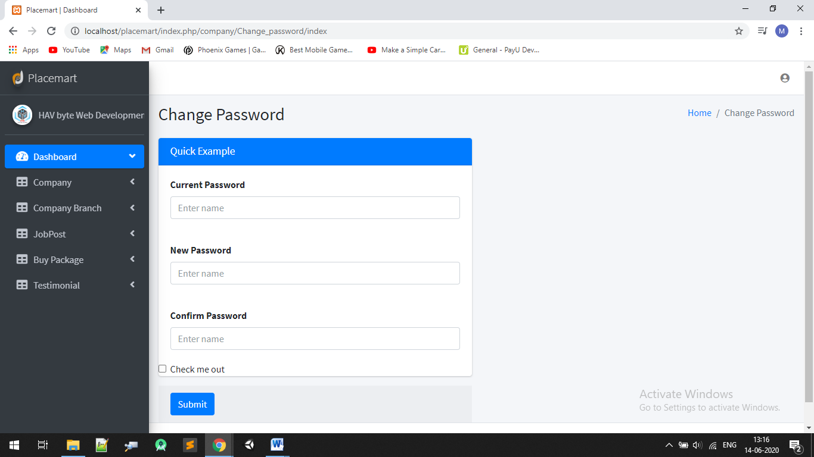
Place your screenshot here
Change Password
38

Slide 39
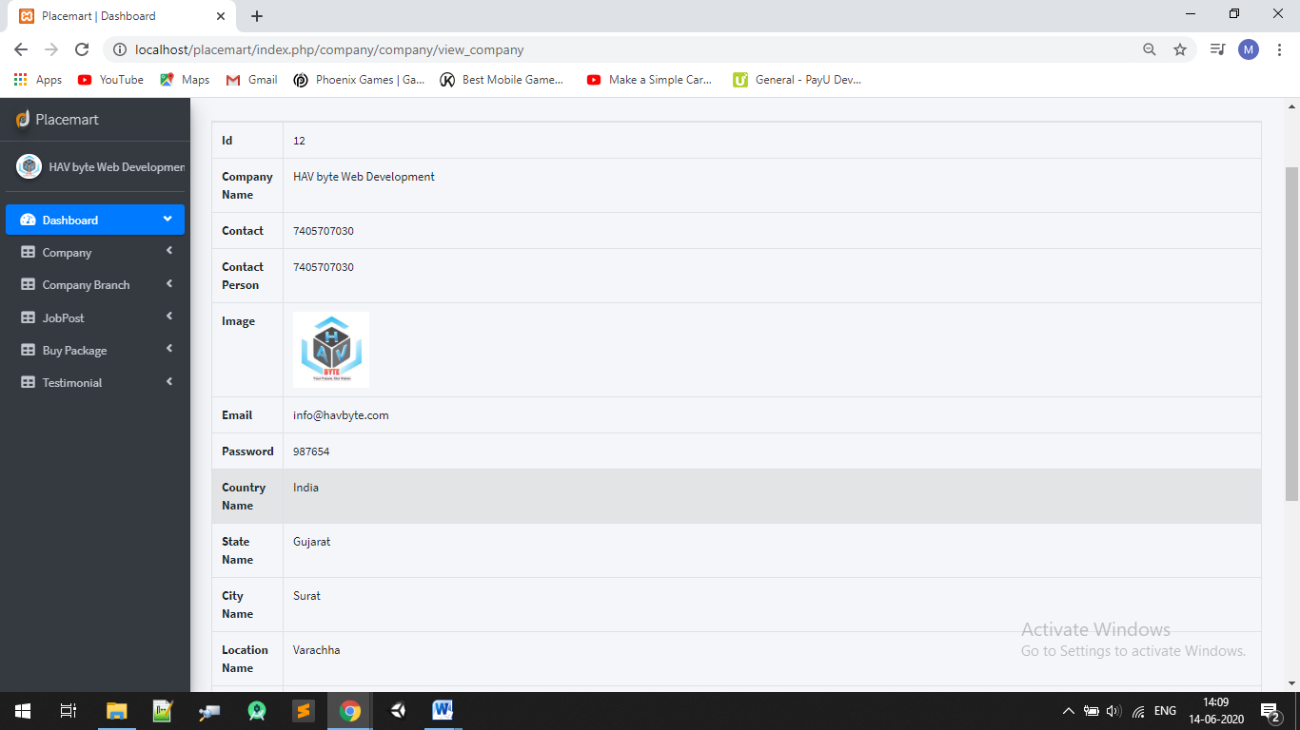
Place your screenshot here
Company Detail
39

Slide 40
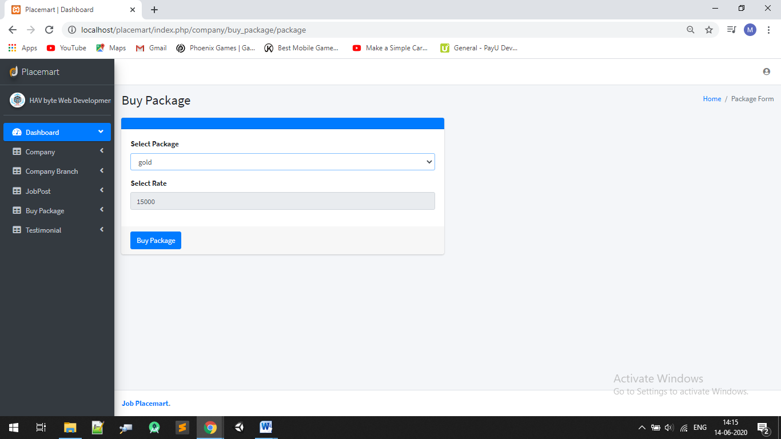
Place your screenshot here
Buy Package
40

Slide 41
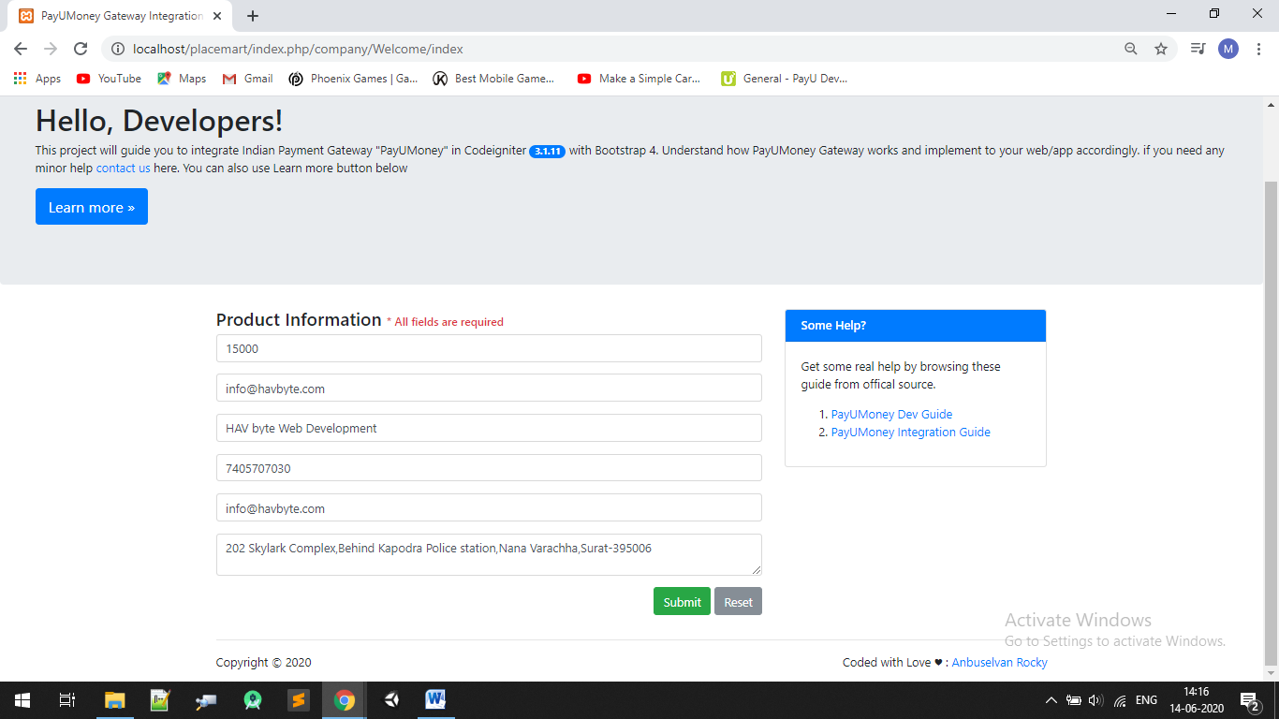

Slide 42
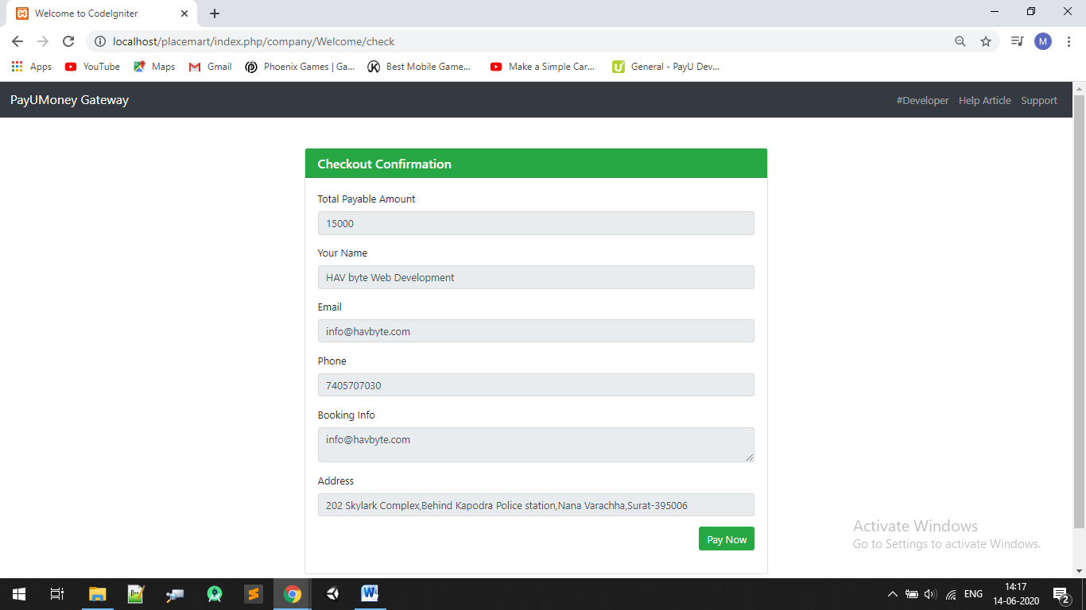

Slide 43
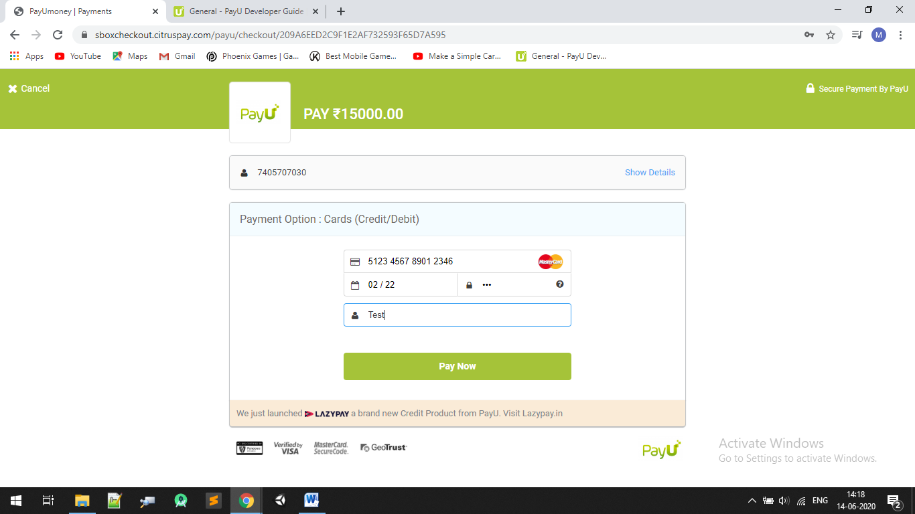

Slide 44
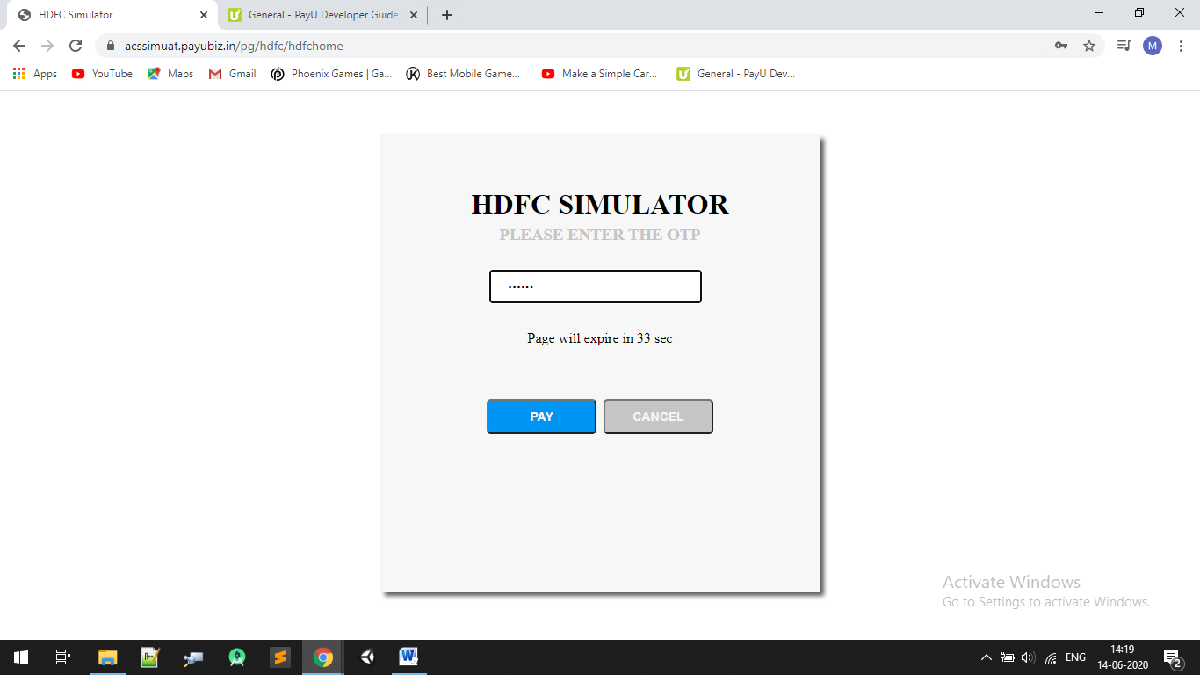

Slide 45
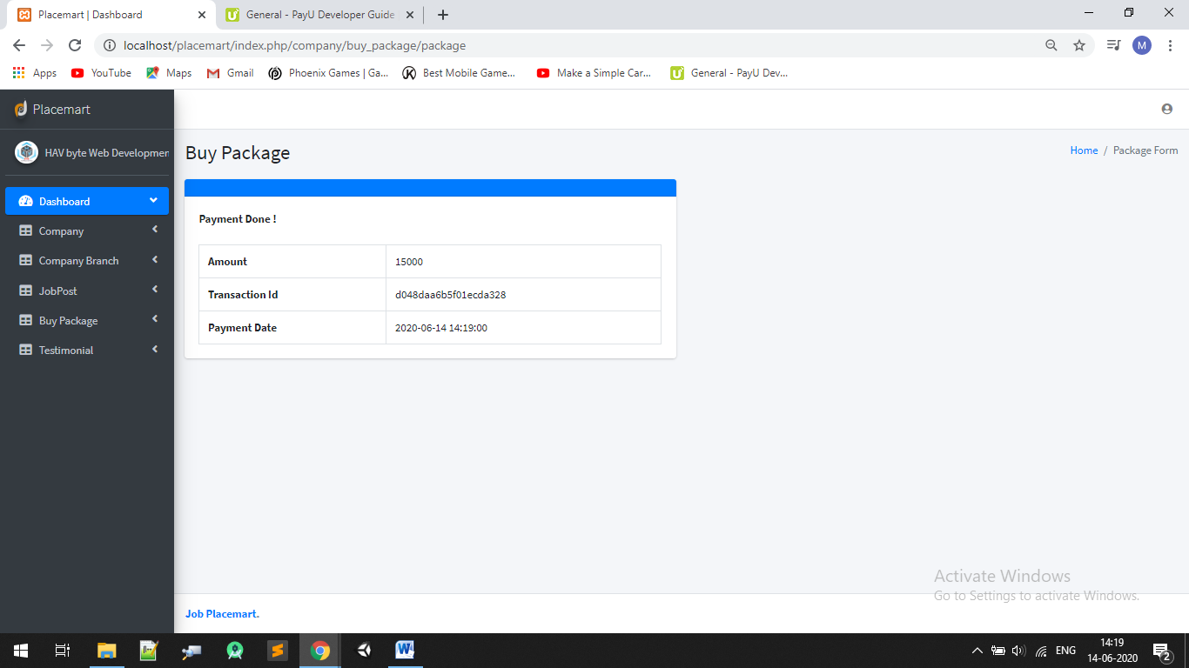

Slide 46
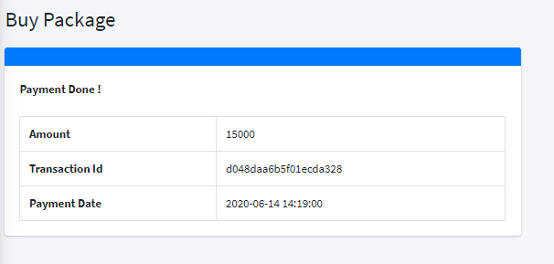

Slide 47
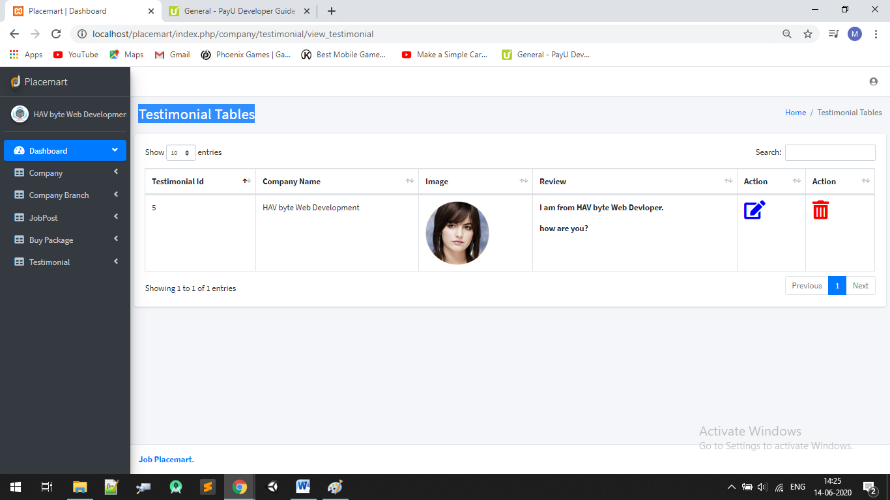
Place your screenshot here
Testimonial Tables
47

Slide 48

Thank you
“Your Career Ocean , Our Care “

